Slide 1
High Performance in Athletics

Slide 2
Motivation.
Client
A coach asked for a favour and I couldn’t say no.
Been burned from the current system many times.
This new one wont work for 1 trick ponies but consistently HP athletes.
Notes:
Needs to be tidied up. May need deleting.

Slide 3
Problem
How do Sponsors select the best Athlete to represent their brand?
Clubs with Money, what upcomming Athletes need support most?
National and International Selection in representing a country. Who has the best potential in performing with the best on the day?
Notes:
Less text on this page. May need deleting also.

Slide 4
What is Currently in Place
Committies
Sponsors
Athlete Carding Program in NZ
Notes:
Talk about each?

Slide 5











Committees and Sponsors
Notes:
Talk about how everyone has different systems in place for selection, money to spend and where, also what type of advertising they are looking at getting out of their brand possibly

Slide 6
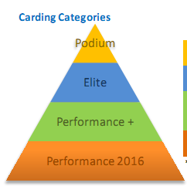
Athlete Carding Program in NZ
What is carding
Its a system set up to fund High Performing Sporting People in New Zealand.
Who gets carded
People who fall into one of
these 4 categories.
Notes:
Talk a bit about what carding is.
Then go on to talk about who gets carded, the different levels of carding <- the different pay grades
Also talk about how this works well for people who are there already but doesnt help potential athletes who could also make this level but lack the funds to do so.

Slide 7
Project Progression
Athletic Level
High Performance / International
National
Youth National / Regional
School
End Result
Project up till this point in time
Currently Available Solution
Notes:
Maybe have this animated.
The red indicates what is currently in place and who benefits most from the system.
The orange represents where the project is at and who can use it effectively to determine their progression in the sport.
The green represents where the project will end up. Also say that even though sponsors and international teams might not be interested in school kids, clubs are very interested in developing the young generation to see them succeed in society.
Remove ccolors

Slide 8
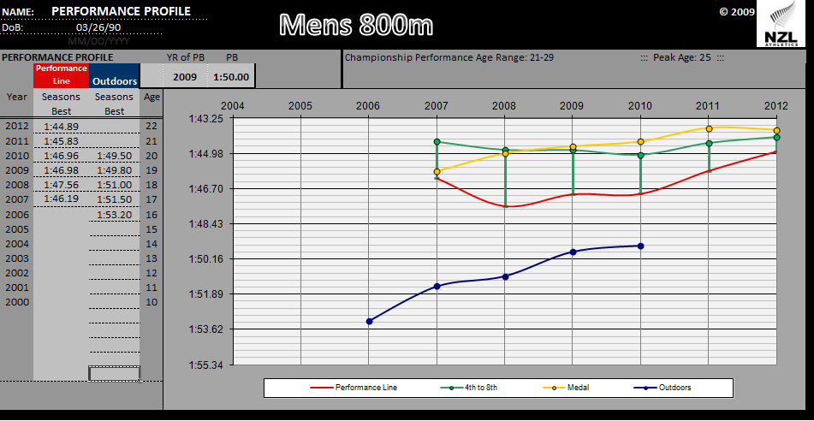
Athlete Carding Program
Notes:
Discuss the different lines and what they represent. Maybe have it animated.
Blue = You or the athlete being charted.
Red = Lowest level to reach in order to get carded in New Zealand
Green = 4th – 8th positioning at Olympics or World Champs.
Yellow = Medal position at Olympics or World Champs.
The flaws with this chart.
You have some unusual calculation where medals and finals are flipped at the start. This shouldnt be possible but for whatever data they modeled off this is the case.
The graph is plotted off your seasons best which is great for people who can preform really well but not so good if they cant continuously produce that same result.
It works of achieving a certain level. “You must be above this line to be of any use to us” Unfortunatly with this there is no room for error, such as injury, illness, or various other factors that can contribute to this one race for the season.
It doesnt show your season activity only your best. This means that you wont be recognised for consistency, only best performance.

Slide 9
The Project
Identifying new talent
Development and progression over years
Reference Clients Research and how the software helps this
Collecting Data and Looking at it
Notes:
Collect Data –Time Frame, how long it took, when
What could be better
Countinuously updating

Slide 10
Results so far
ATHNZL going to use this in place of the old

Slide 11
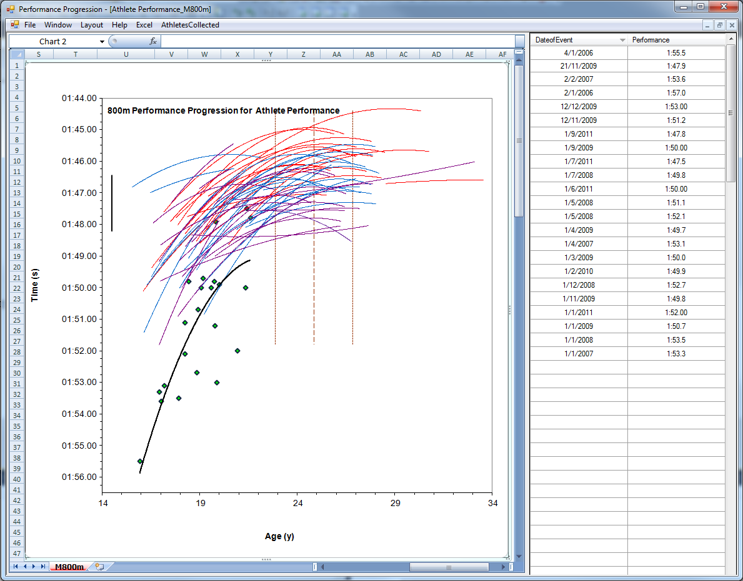
What I’ve done so far
Notes:
Talk about what the athlete is shaping out to be.

Slide 12
What I’ve done so far
Data collected
Notes:
Talk about what the athlete is shaping out to be.

Slide 13
Demo

Slide 14
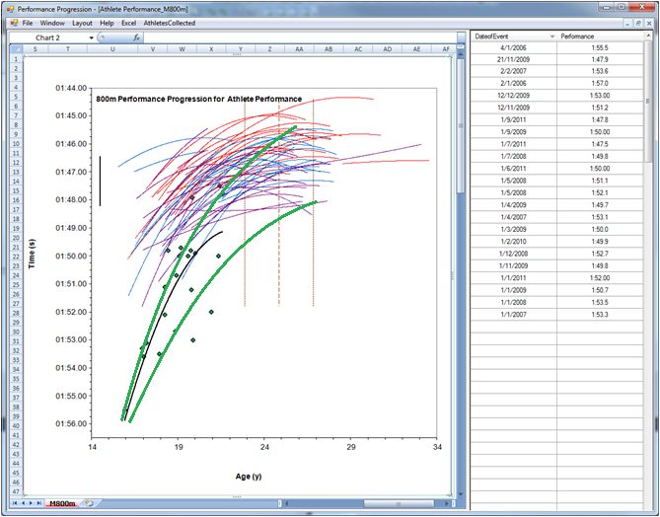
The Plan - Error Funnel

Slide 15
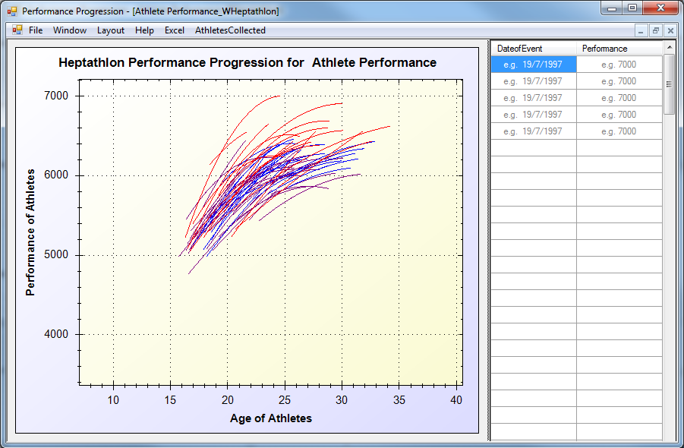
The Plan -Dynamic Graph

Slide 16
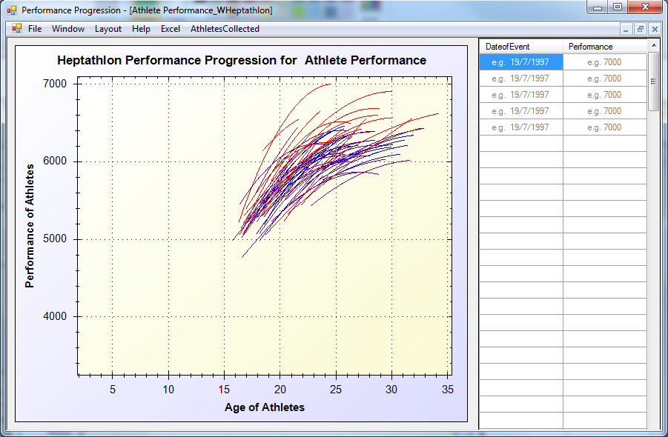
The Plan –Dynamic Graph

Slide 17
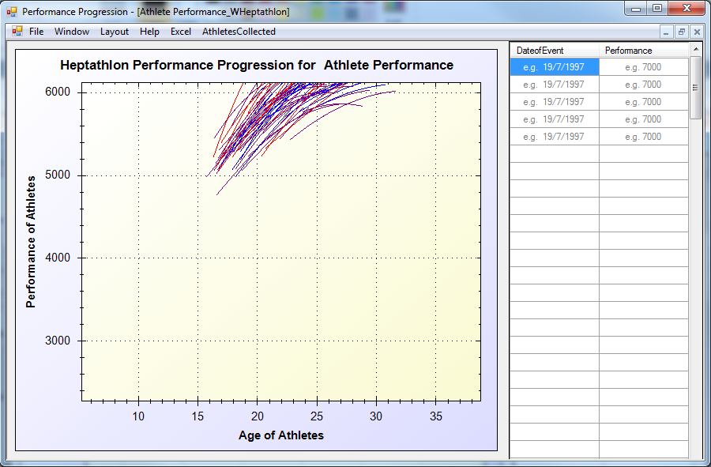
The Plan –Dynamic Graph

Slide 18
What I plan to do
Data collection Automated.
Dynamic Graph

Slide 19
What I plan to do
Data collection Automated.
Dynamic Graph

